Slide 1

Knights
Sagel
Tadiwa
Talia
Linda
UCT
HACKATHON 2020

Slide 2


Problem
Increase in unemployment rates during the Covid-19 pandemic.
Salary cuts
Companies shutting down
Fall of the economy accelerated poverty

Slide 3

The Facts
The youth makes up to 35% of SA’s population
Youth unemployment was at 55.9% as of 2019
As of 2020 unemployment is at 59%
Lack of soft skills is a major contributor

Slide 4


Solution
WEBSITE
Our solution aims to use entrepreneurship to uplift the youth and the economy.
We have created a data free app called KnowledgeBump.
How does the app operate?
Offers soft skills training courses
Connects users to entrepreneurship opportunities and job opportunities
Generates a CV for users
Advertises for small business

Slide 5
Why is our solution DIFFERENT?
WEBSITE: ALL IN ONE, THE SEARCH IS OVER
We’re not your usual online learning
or job search app!
We offer different niches.
Teach soft skills > So you are employment ready!
Build a community. It is not just a website, it is a journey!
Mentorship: We give you the tools (learn) and teach you how to use them
Business plan as a budding entrepreneur? We got you
CV revamp? We have that too!
Career advice? Someone who has been there can help you!

Slide 6

WHY IS OUR SOLUTION EFFECTIVE?
●●● SIMPLE ●●●
●●● ACCESSIBLE ●●●
●●● USER FRIENDLY ●●●
Our solution is simple, accessible and user friendly!
Simple: the website will have a user-friendly interface where all the relevant tabs are clearly labelled and easy to find. The person will be directed to the relevant pages by simply clicking on the tab names and thereafter can access all the information.
Accessible: we do not use an app where people have to download, but instead simply a link that can be passed on via SMS or written up at library notice boards where people could freely access our sites through the public library or their phones. We will partner up with internet service providers like Cell C and MTN in order to provide our site for free. This is important because we solve the data issues that arise with most technology-based solutions.
User friendly: our interface is colorful, simple and easy to navigate. In future we will add voice reading tools that can read what’s on the page in order to facilitate learning for those struggling with English to begin with.

Slide 7
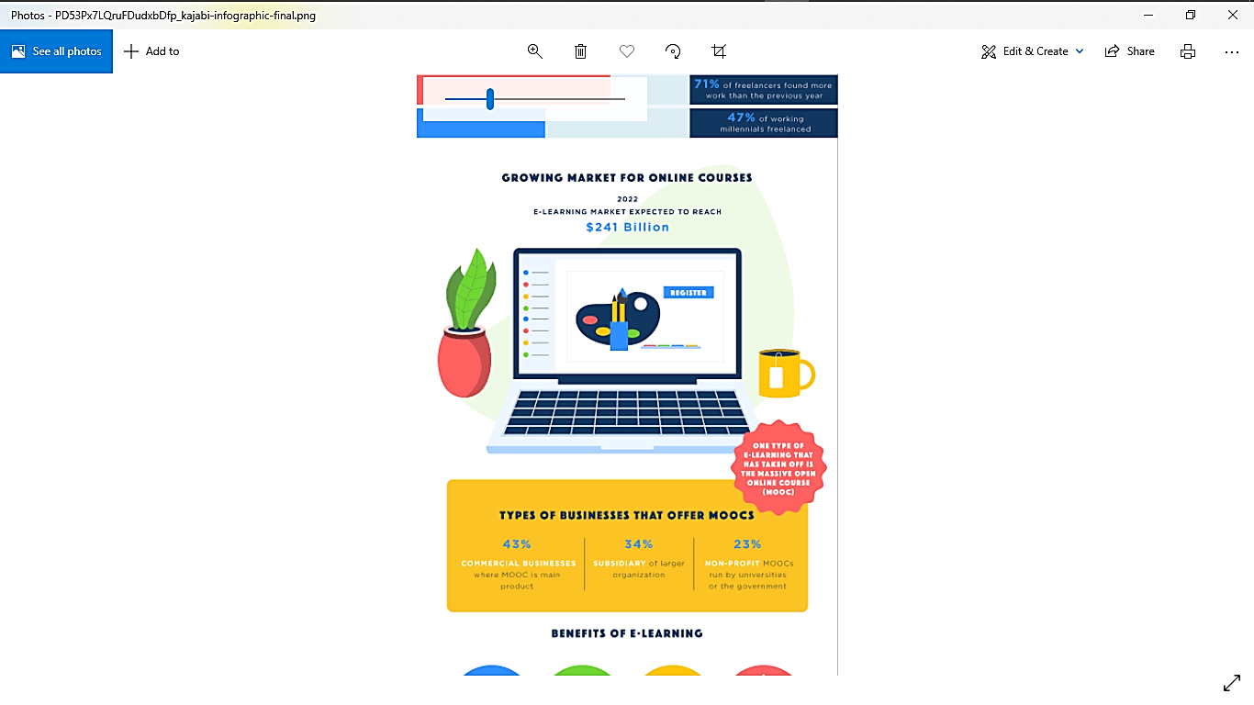
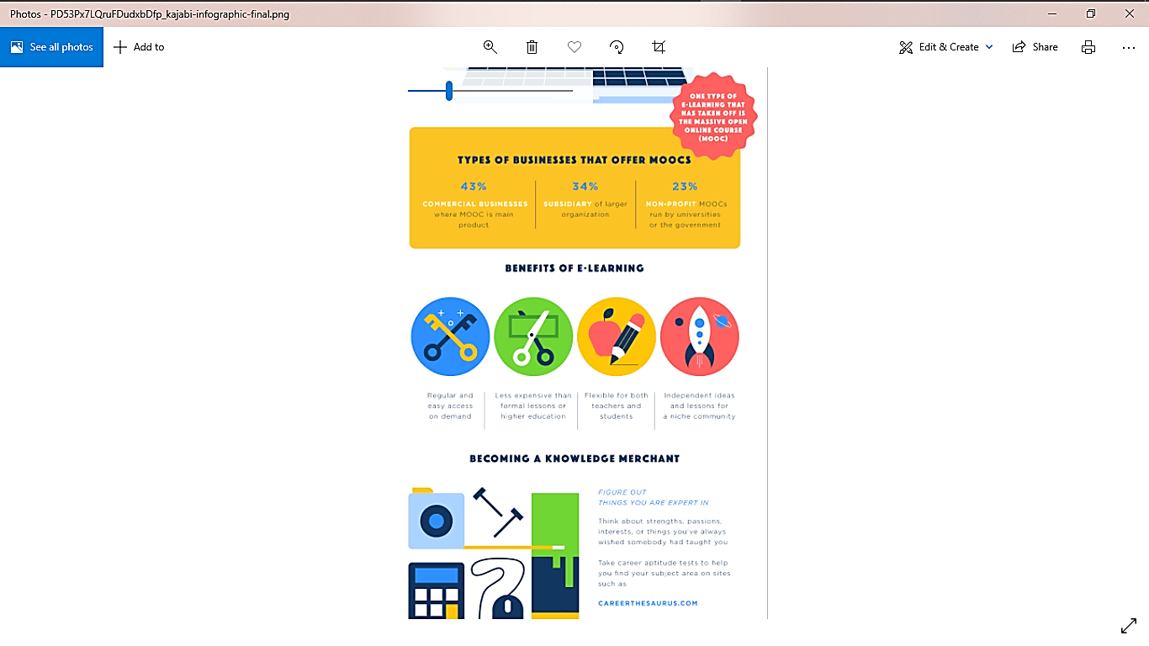
FUTURE POSSIBILITIES: Infopreneurship
The website can be used a platform for infopreneurs! This means that individuals can create courses and sell to the market on the website. This is particularly important because the online market is growing and is estimated to be a $241 billion market by 2022 only! Hence, we will be allowing individuals to have a piece of that cake and pass on their skills. (source: marktechpost)

Slide 8
NEW IN THE MARKET: All you need in ONE PLATFORM
Employment
Community
Knowledge
Connecting knowledge accessibility with employment.
Offering a community to connect small businesses to consumers!
Empowering youth with skills, mentorship and guidance so they can excel!

Slide 9

https://github.com/tadiwacm/KnowledgeBump
We will not take you to our live demo. Enjoy!

Slide 10

THANK YOU!

